Slide 1
Module 4 Data Integration Concepts, Processes, and Techniques
Lesson 5: Matching and Consolidation
Notes:
Welcome to Lesson 5 of Module 4 on data integration concepts, processes, and techniques.
Opening question

Slide 2
Lesson Objectives
Discuss an important application for entity matching
Explain the need for labor intensive investigations
Reflect on the relationship between entity matching and consolidation
Notes:
Lesson 5 explains entity matching and consolidation.
Very detailed subject so the presentation emphasizes basic concepts and goals

Slide 3
Entity Matching
Identify common entities from separate data sources
Difficult matching process: no common identifier
Data mining problem
Also known as the record linkage, entity identification, and entity resolution
Many approaches
Improve data quality for better matching results
Notes:
Many applications
Complex details
Studied for decades

Slide 4
Matching Example
Source 1
First name | Aimee
Middle name | Christina
Last name | Parker
Job title | Product Manager
Firm | Microsoft Corporation
Street | 15580 NE 31st Street
City | Redmond
State | WA
Postal Code | 98052
Country | USA
Source 2
First name | Aimee
Middle name | C.
Last name | Parker-Lewis
Job title | Prod. Mgr.
Firm | Microsoft
Street | 16517 78th Place NE
City | Bothell
State | WA
Postal Code | 98020
Country | USA
Notes:
Source 1 has pre marriage name and work address.
Source 2 has marital name and home address.

Slide 5
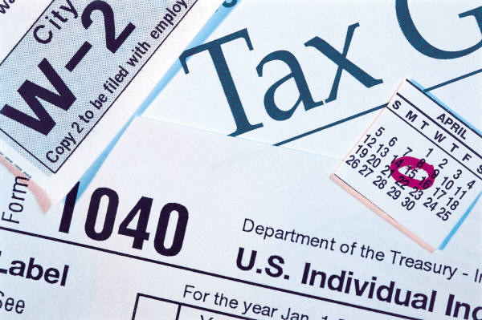
Entity Matching Applications
Marketing
Law enforcement
Fraud detection
Health care
Notes:
Marketing: merge mailing lists; combine customers from different companies after merger
Law enforcement: link crimes to individuals; usages of aliases
Fraud detection: filing fraudulent tax returns with different Social Security numbers
Health care: combining health records from same individuals treated at different clinics

Slide 6
Entity Matching Outcomes
Predicted | Actual
 | Match | Non Match
Match | True match | False match
Possible Match | Investigation | Investigation
Non Match | False non match | True non match
Notes:
To obtain a more precise understanding of the problem, the outcomes of comparing two cases should be understood. The outcomes of entity identification are similar to standard classification problems as shown in this table. The rows represent predictions and the columns represent actual results of matching two records for duplication. A true match involves a predicted match and an actual match allowing the two records to be combined correctly. A false match involves a predicted match but an actual non match resulting in two records combined that should have remained separate. A false non match involves a prediction of non match but an actual match resulting in two records remaining separate that should be combined. A true non match involves a prediction of non match and actual non match resulting in two separate records remaining separate. The “possible match” situations involve predictions with too much uncertainty. Investigation is required to resolve cases with high uncertainty in match prediction.

Slide 7
Consolidation
Merging matched records
Linking matched records
Households
Transactions
Notes:
Merging
Combine records from different sources
Typically people but also firms and other entities
Rules to discard conflicting data such as older addresses
Rules to insert new fields to preserve data from multiple sources such as home and work addresses
Linking
Maintaining separate target records but note relationships
Households: linking individuals living together both family and non family
Transactions: link transactions such as different insurance policies

Slide 8
Merging Example
Target
First name | Aimee
Middle name | Christina
Last name | Parker-Lewis
Job title | Product Manager
Firm | Microsoft Corporation
Street | 16517 78th Place NE
City | Bothell
State | WA
Postal Code | 98020
Country | USA
Notes:
Eliminate work address
Use latest name (married)

Slide 9
Household Consolidation
George
Smith
Janet
Smith
Karen
Smith
Thomas
Smith
Notes:
We often want to consolidate data based on who lives in the same household. This is referred to as “house holding.”

Slide 10
Transaction Linking
Account No. 83451234
Policy No. ME309451-2
Transaction
B498/97
Notes:
The three accounts are really held by one person.
Link transactions to the same person

Slide 11
Summary
Importance and difficulty of entity matching
Costly disposition of possible matches
Consolidate by merging and linking
Notes:
Importance of entity matching: many applications
Difficulty
Many approaches
Varying results with different approaches
Quasi identifiers
Other almost unique fields that are common in data sources
Name
Address
Postal code
Possible matches:
Not enough certainty for match or non match
Requires manual intervention
Consolidation
Merge where possible by deleting some conflicting data and adding data from some sources
Linking: households and transactions (over time)

